Slide 1


COMMON ERRORS IN ENGLISH

Slide 2
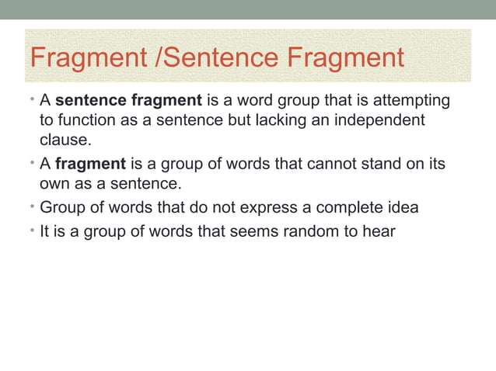

Slide 3
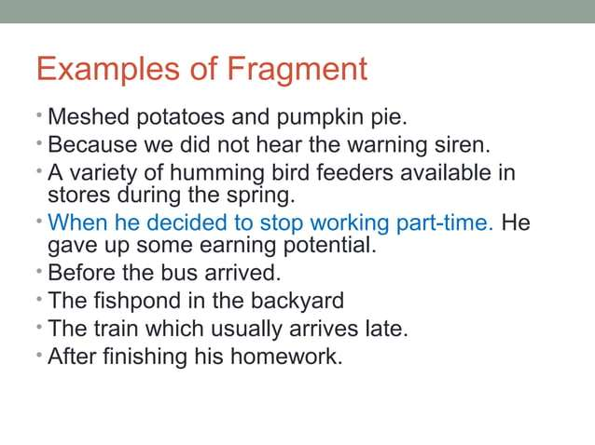

Slide 4
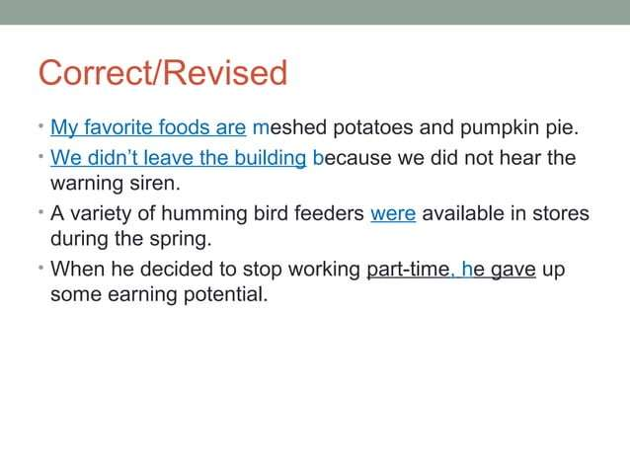

Slide 5
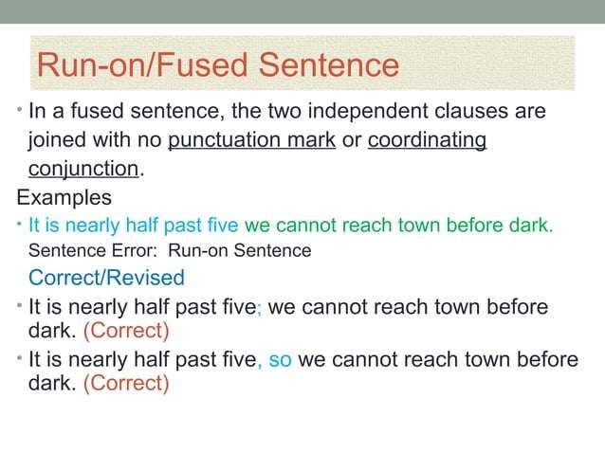

Slide 6
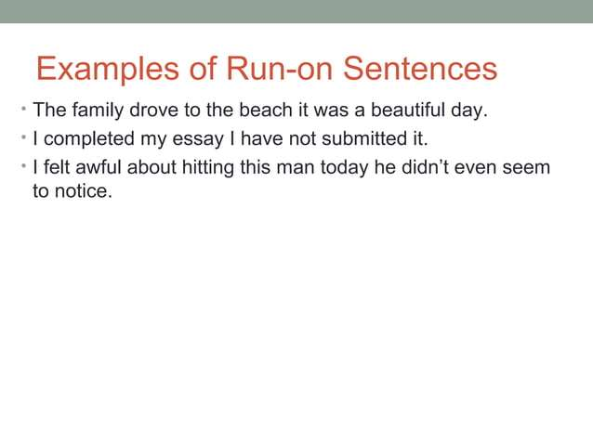
Answers:
Original: The family drove to the beach it was a beautiful day.
Correction:
Separate with a period: "The family drove to the beach. It was a beautiful day."
Combine with a semicolon: "The family drove to the beach; it was a beautiful day."
Combine with a conjunction: "The family drove to the beach because it was a beautiful day."

Slide 7
Original: I completed my essay I have not submitted it.
Correction:
Separate with a period: "I completed my essay. I have not submitted it.“
Combine with a semicolon: "I completed my essay; however, I have not submitted it.“
Combine with a conjunction: "I completed my essay, but I have not submitted it.“
Original: I felt awful about hitting this man today he didn’t even seem to notice.
Correction:
Separate with a period: "I felt awful about hitting this man today. He didn’t even seem to notice.“
Combine with a semicolon: "I felt awful about hitting this man today; he didn’t even seem to notice.“
Combine with a conjunction: "I felt awful about hitting this man today, yet he didn’t even seem to notice."

Slide 8
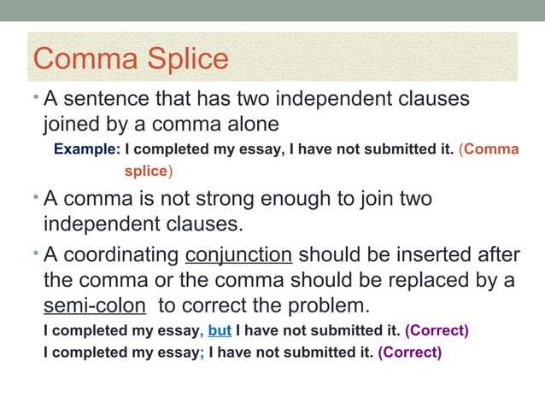

Slide 9
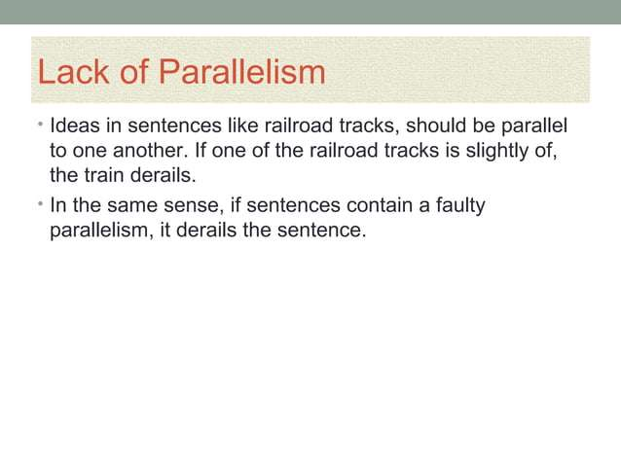

Slide 10
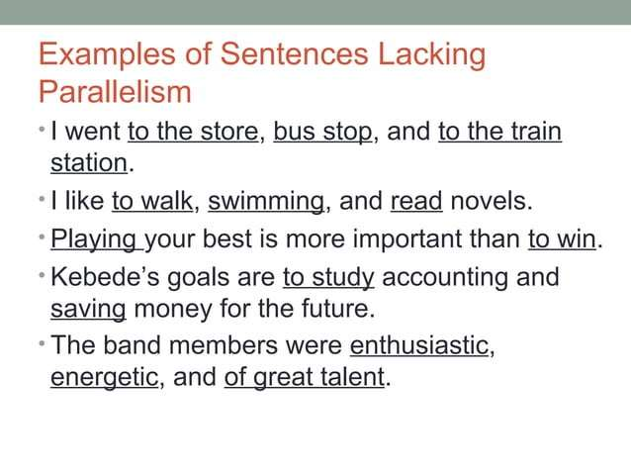

Slide 11
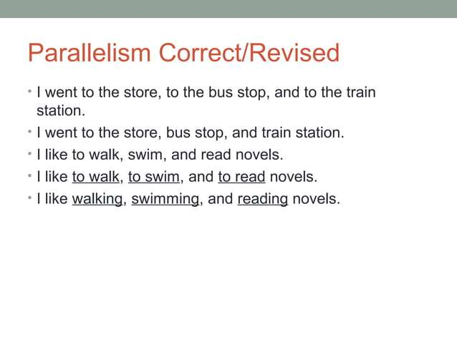
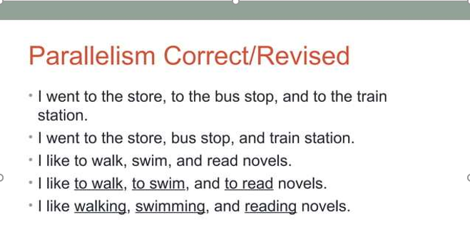

Slide 12
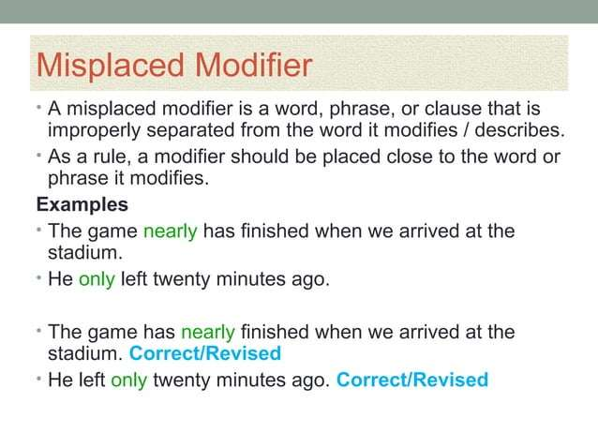

Slide 13
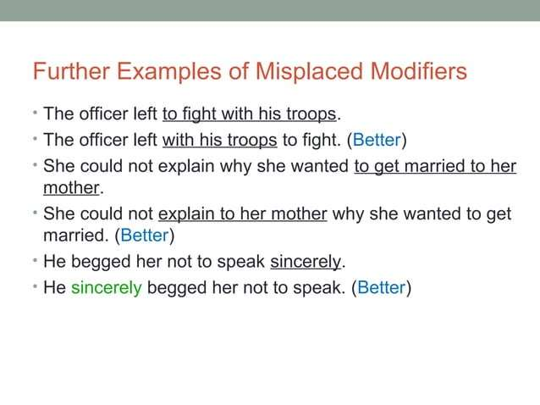

Slide 14
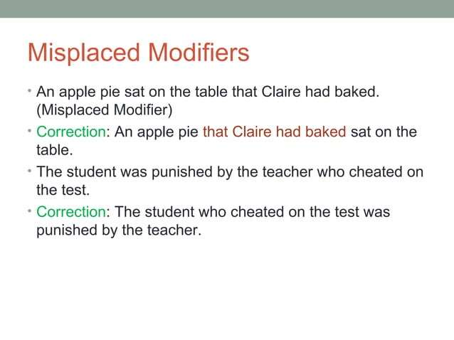

Slide 15
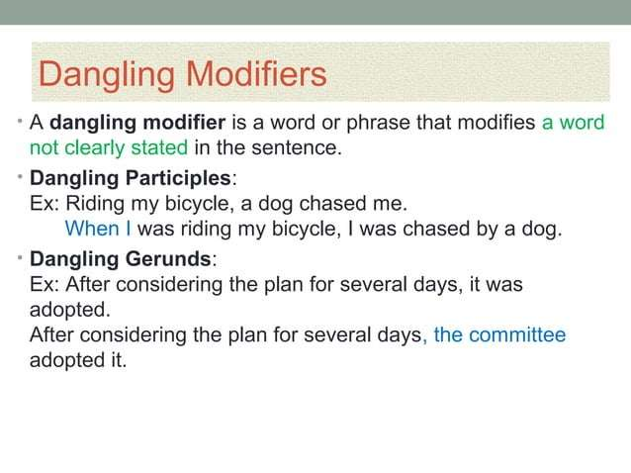

Slide 16
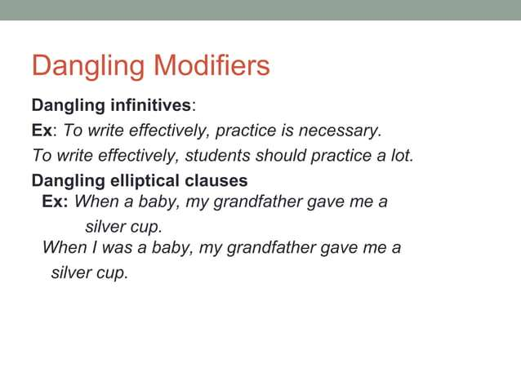

Slide 17
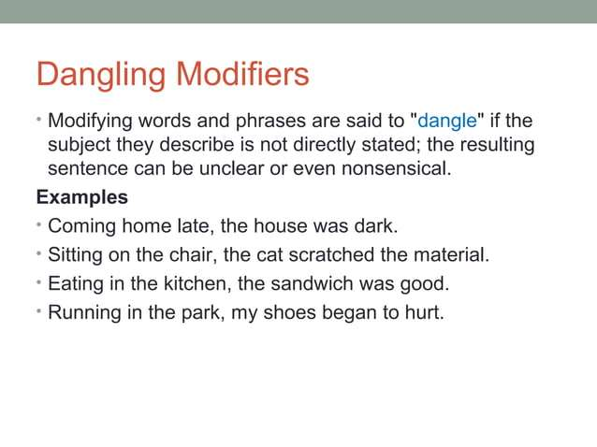

Slide 18
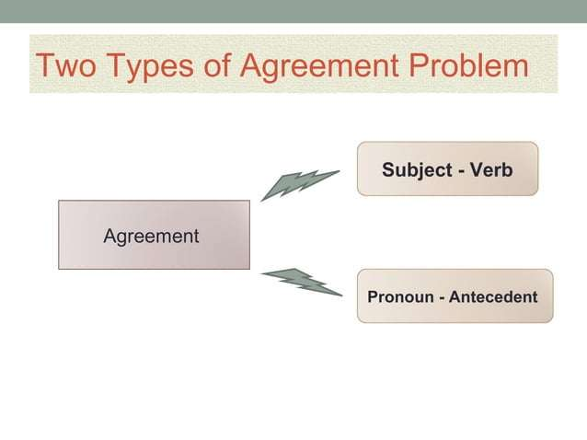

Slide 19


Slide 20
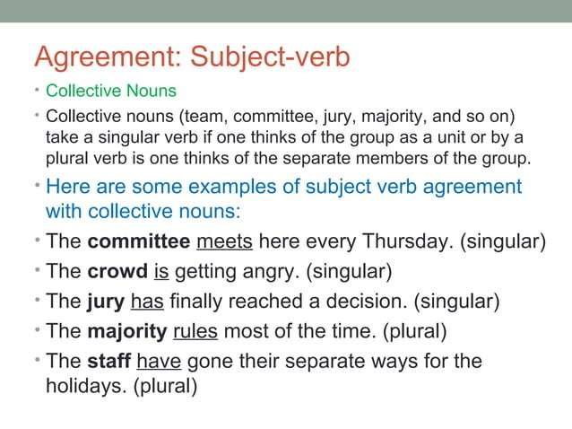

Slide 21
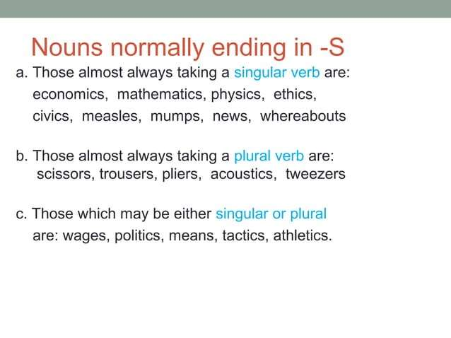

Slide 22
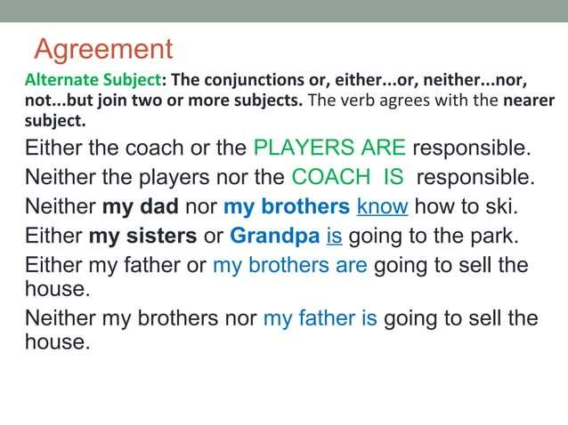

Slide 23
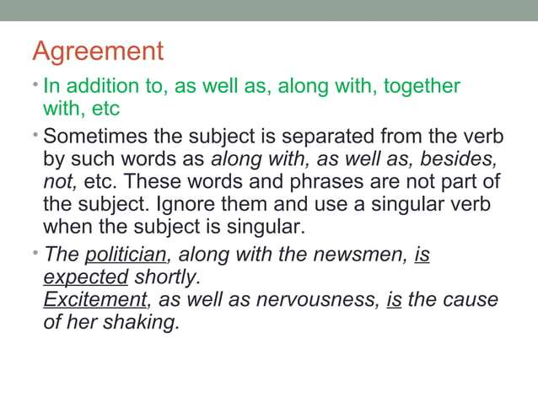

Slide 24
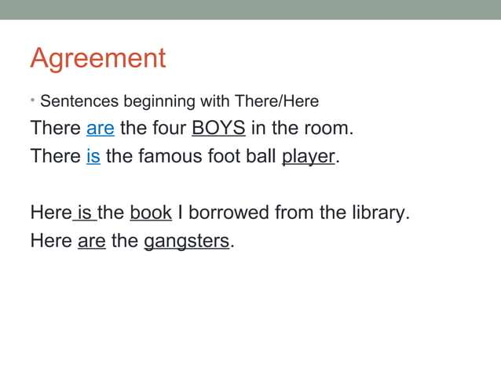

Slide 25
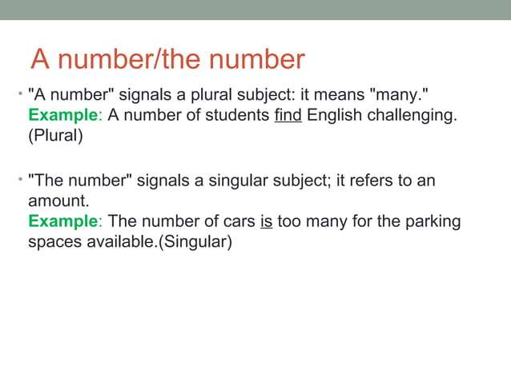

Slide 26
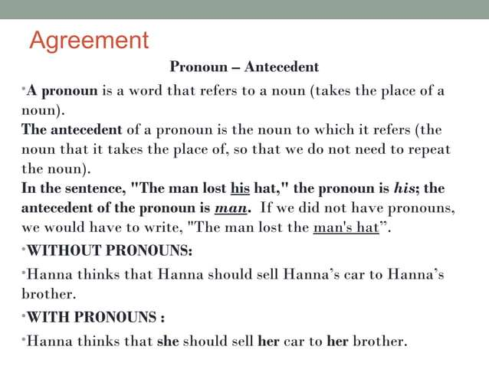

Slide 27
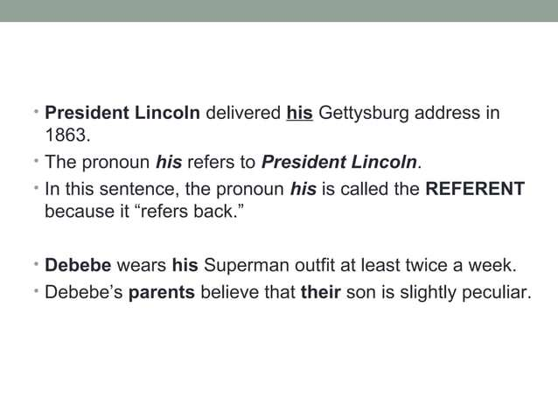

Slide 28
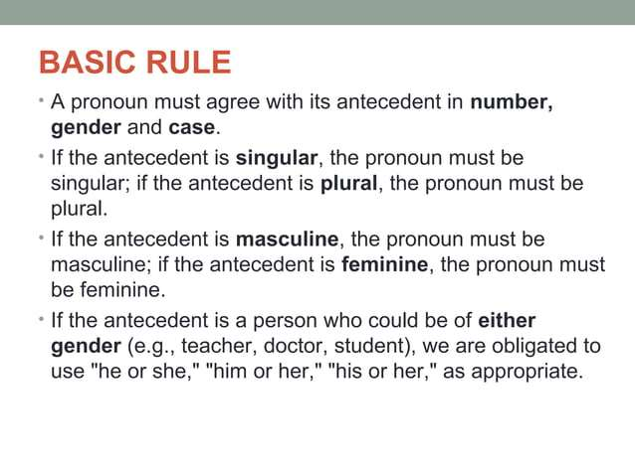

Slide 29
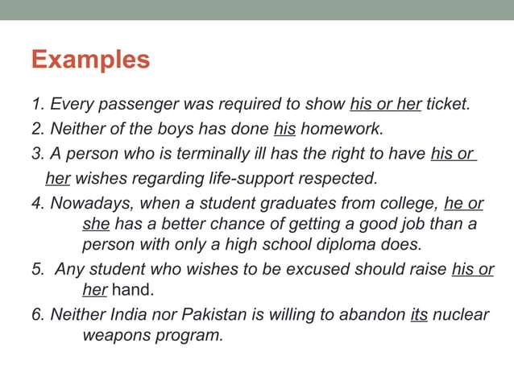

Slide 30
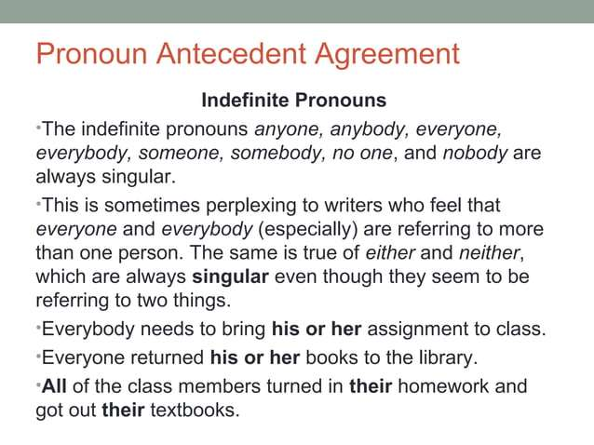

Slide 31


Slide 32
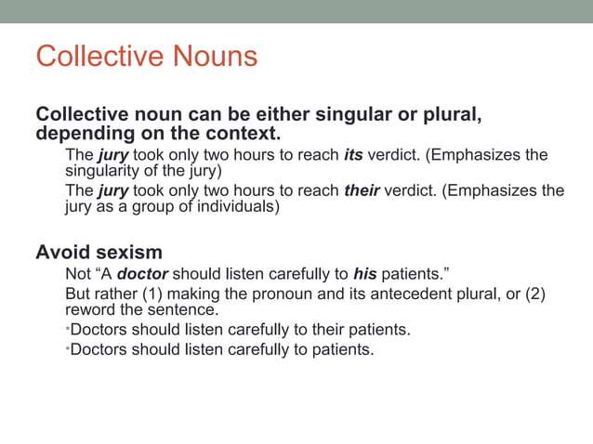

Slide 33
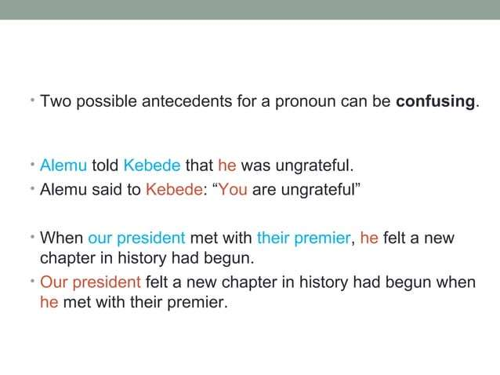

Slide 34
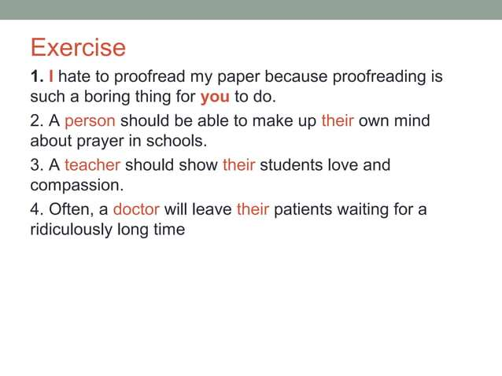

Slide 35
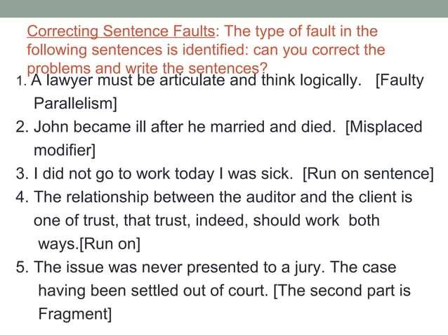

Slide 36
